Slide 1
Templates

Slide 2
Template
It is an approach where generic types are used as parameters in algorithms so that they work for a variety of suitable data types and data structures.
Generic classes
Generic functions

Slide 3
Templates
Class template- For eg. An array class for multiple data types(int , float etc.).
Function template- For eg. A function mul() for multiplying int, float, double data types.

Slide 4
Templates
A template is a mechanism that allows you to create functions and classes that can be reused with every data types.
Template is defined with a parameter that would be replaced, the templates are sometimes called as parameterized classes or functions.

Slide 5
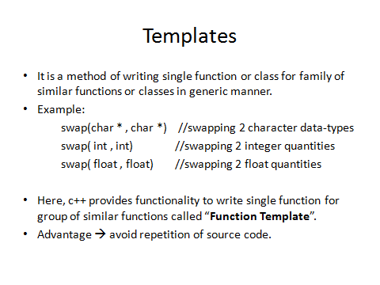

Slide 6
Example
To add 2 no.(2 int, 2 float, 2 double)
One method can be – define a different function for each
Second method can be- define a template with generic datatype as parameter

Slide 7
Syntax of class Template
template<class T>
Class classname
{
//……………
//Class member specification with
//anonymous type T
//wherever appropriate.
……………
};
T may be substituted by any datatype including user defined datatypes.

Slide 8
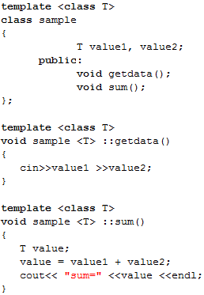
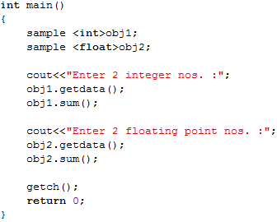
Class Template example

Slide 9
// class templates
#include <iostream.h>
template <class T>
class pair
{
T value1, value2;
public: pair (T first, T second)
{value1=first;
value2=second;
}
T getmax ();
};

Slide 10
template <class T>
T pair<T>::getmax ()
{ T retval;
retval = value1>value2? value1 : value2; return retval;
}
int main ()
{ pair <int> myobject (100, 75);
cout << myobject.getmax();
return 0; }

Slide 11
Class template with multiple parameters
Template <class T1, class T2,….>
Class classname
{
……..
………(body of the class)
};

Slide 12
Two generic data types in a class
#include<iostream>
template<class T1, class T2>
Class display
{
T1 a;
T2 b;
Public:
display(T1 x, T2 y)
{ a=x;
b=y;}
Void show()
{ cout<<a<<“and”<<b;}
};
main()
{
display <float,int>d1(1.23,12);
display <int ,char> d2(20, ‘z’);
d1.show();
d2.show();
};
Output:
1.23 and 12
20 and z

Slide 13
Function Templates
Template <class T>
returntype functionname(arguments of type t )
{
// body of function with type T
………..
}

Slide 14
Example
Template <Class T>
Void swap(T& x , T& y)
{
T temp= x;
X=y;
Y= temp;
}
Void f(int m, int n,float a,float b)
{
Swap(m,n);
Swap(a,b);
}
main()
{
f(2,3,3.1,4.2);
}

Slide 15
Example of function template
#include <iostream.h>
Template<class T>
Void swap(T &x, T &y)
{
T temp= x;
x=y;
y= temp;
}
Void fun(int m, int n,float a, float b)
{
cout<<m and n before swap:<<m<<“”<<n;
swap(m,n);
cout<< m and n after swap:<<m<<“”<<n;
cout<<a and b before swap:<<a<<“”<<b;
swap(a,b);
cout<< a and b after swap:<<a<<“”<<b;
}
Int main()
{
fun(10,30,23.32,45.32);
Return 0;
}

Slide 16
Function templates with multiple parameters
Template<class T1,class T2,…..>
returntype functionname(arguments of type t1,t2,…..)
{
//………
//body of the function
//……..
}

Slide 17
Function with two generic types
#include<iostream.h>
#include <conio.h>
Template<class T1,class T2>
Void display(T1 x, T2 y)
{
Cout<<x<<“”<<y<<“\n”;
}
Int main()
{
display(10,25.34);
display(‘a’,200);
return 0;
}

Slide 18
Overloading of template functions
A template function may be overloaded either by a template function or ordinary function.
Overloading resolution is accomplished as:
  Call ordinary function that has an exact match.
  Call a template function that could be created with an exact match.

Slide 19
Overloading of template function
#include<iostream.h>
#include<conio.h>
Template<class T>
Void display(T x)
{
cout<<“Template display”<<x<<“\n”;
}
Void display(int x)
{
cout<<“Explicit display<<x<<“\n”;
}
Int main()
{
display(100);
display(56.78);
display(‘a’);
return 0;
}

Slide 20
Member function templates
Template <class T>
returntype classname<T>::functionname(argument_list)
{
//……
//function body
//……
}

Slide 21
Non- Type Template Arguments
In addition to type T arguments, we can also use other arguments like int, char etc.
Template <class T, int size>
Class array
{
T a[size];
//………
//………
};
array<int,10> a1;
array<float,5> a2;
array <char,50> a3;

